Slide 1
Portfolio Project presentation
Jose Vargas
Colorado State University Global
MIS581: Capstone – Business intelligence and data analytics
Dr. justin bateh
February 9, 2025
Notes:
Hello professor and/or class.
My name is Jose Vargas, and this is the final presentation of my capstone project for the capstone course.

Slide 2
Introduction
Speakers
Jose Vargas
Masters in Data Analytics
Specialization in Artificial Intelligence and Machine Learning
Structure of Presentation
Statement of research problem statement and proposal
Discussion of research problem and research design (Research objectives, hypotheses testing, methodology, data collection and analysis)
Results
Recommendations
Conclusion
Notes:
Hello professor and/or class.
My name is Jose Vargas, and this is the final presentation of my capstone project for the capstone course of my masters in data analytics with a specialization in AI and ML.
I will begin by stating the research problem and a proposal to address this problem.
I will then take a deeper dive into the research problem and the selected research design.
Lastly, I will go over the results of my research including descriptive and statistical analysis pertaining to the research problem as well as some recommendations and a conclusion derived from these results.

Slide 3
Research problem

Slide 4
Background
Telecommunications is critical for business and personal relationships in modern society.
This industry comprises the transmission of information through various forms of media.
The telecom industry is one of the few that has benefited from the recent technology and artificial intelligence advancements.
New technology and analytics solutions can help address one of the major issues in this industry: customer churn
Can historical customer data help predict the likelihood of a customer churning?
Can a predictive model help companies identify which attributes provide key insights into at-risk customers?
Notes:
Regardless of what industry most people are in, telecommunications play a big role in the lives of everyone, from connecting us to our loved ones, to leveraging telecommunications for business and the sharing of all sorts of information.
According to AAI-Persona.org, telecommunications can be defined as “…the transmission of information through various media such as radio, television, telephone, and the internet. It is a critical component of modern society, enabling people to communicate, share information, and access entertainment from anywhere in the world.”
Despite recent advances in technology and AI, which may have negatively impacted other industries, the telecom industry has placed itself in a position where most business depend heavily on it to conduct their day-to-day business operations successfully and efficiently.
I believe this technology and AI boom can help companies in this industry overcome or at least mitigate some of the damage cause by one of the industry’s most prominent problem: Customer churn.
**Read the questions on the slide**

Slide 5
Research objectives
Build a logistic regression model.
Determine what constitutes an at-risk customer.
Pinpoint key attributes that lead to customer churn.
Test the hypotheses/research questions.
Provide recommendations related to data collection and customer retention.
Notes:
Some of the research objectives of my capstone project include the following:
Building a logistic regression model that uses a dataset containing historical customer account and demographic variable as predictor variables, and customer churn as the target variable.
Identify patterns in terms of which attributes have the greatest influence on customer churn to determine which customers are at risk of churn.
Again, pinpoint the key attributes that a company can look at to anticipate customer churn.
Leverage statistical tests in SAS studio to test the null hypothesis of the research questions.
And lastly, provide recommendations to companies in this industry based on the results pertaining to data collection and customer churn to help them proactively establish effective customer retention strategies.

Slide 6
Research hypotheses
How does the type of contract influence customer churn in the telecom industry?
Ho: There is no significant difference in customer churn between customers with different types of contracts.
Ha: There is a significant difference in customer churn in customers based on the type of contract.
Is there a relationship between the type of internet service (DSL, Fiber Optic) and churn?
Ho: There is no significant difference in churn rate between customers with Fiber Optic internet service, and those with DSL internet service.
Ha: There is a significant difference in churn rate between customers with Fiber Optic internet service, and those with DSL internet service.
Do accounts with multiple lines have lower churn rate than accounts with an individual line?
Ho: There is no significant difference in customer churn between account with one line, and accounts with multiple lines.
Ha: There is a significant difference in customer churn between accounts with one line versus accounts with multiple lines.
Notes:
The first question attempts to determine whether the type of contract (such as month-to-month, year, or 2-year) has a significant effect on customer churn.
The null hypotheses states that the type of contract has no significant effect on customer churn while the alternate hypothesis states the opposite.
The second question tries to determine whether there is a significant difference in customer churn based on the type of internet service in a customer account such as DSL or Fiber Optic.
The null hypothesis argues that there is no statistical difference based on the type of internet service while the alternate hypothesis argues the opposite.
The last research question asks whether customers with multiple lines in their account have a lower churn rate than customers with a single line.
The null hypothesis states that there is no significant difference in churn rate between these two groups, the alternate hypothesis states the opposite.

Slide 7
Research design

Slide 8
Methodology
Telco customer churn dataset as the main dataset.
Quantitative methodology.
SAS Studio as the main tool for descriptive, statistic, and predictive data analysis.
Data analysis tasks are driven by the research questions.
Data collection through SAS Studio.
Notes:
The main dataset used in this research is the telecommunications customer churn dataset, which is primarily composed of binary, categorical, numerical data.
A quantitative methodology is employed as I am leveraging numeric and binary variables in statistical analysis to build a prediction of customer churn.
Data collection, preprocessing, and initial analysis is conducted through SAS Studio, these steps include exploratory descriptive analysis to understand the distribution available attributes, and subsequent creation of the logistic regression model, as well as an interpretation of its results.
Descriptive and statistical tests are driven by the research questions generated to either accept or reject the null hypothesis.

Slide 9
Results

Slide 10
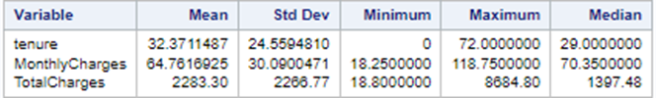
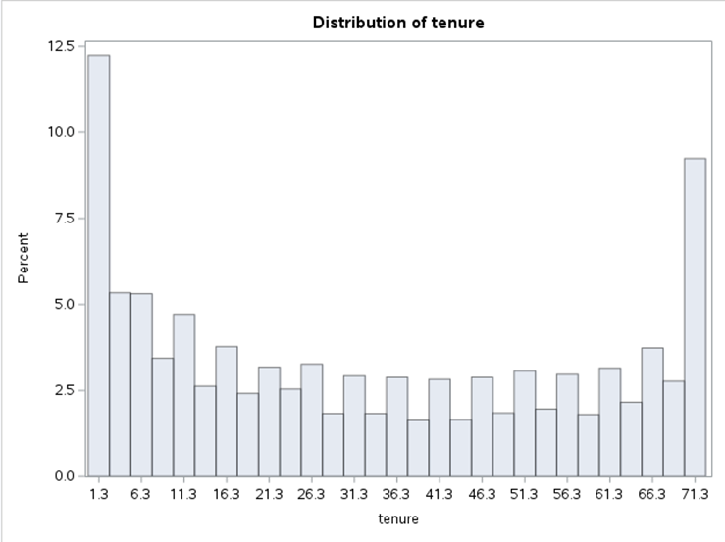
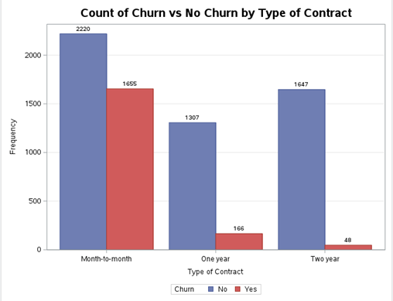
Data analysis
Basic summary statistics of continuous variables indicate significant variability.
Descriptive analysis shows non-normal distributions with significant skew.
Filters help remove or reduce the presence of extreme outliers.
Descriptive visuals point to potential relationship between predictors and target variable.
Notes:
The basic summary statistics task in SAS studio computes basic statistics metrics pertaining to continuous variables in the dataset. The measures selected measure the central tendency and dispersion of the continuous variables in the dataset in order to understand the distribution of these variables.
A valid interpretation of the table in the slide, looking at the “Tenure” variable for instance, is the following:
Customers have been with this provider, on average, for 32.4 months. As displayed by the mean.
The standard deviation value is relatively close to the median value, indicating significant variability.
A minimum value of 0 implies that some customers have been with this provider for 0 months which could indicate that these are new customers.
At least one customer has been with this provider for a maximum of 72 months.
The median value of 29 indicates that about half of the customers in this dataset have been with this provider for 29 months and the other half have been with this provider for more than 29 months.
A similar interpretation to the one I just gave is true for the other variables.
I also included a histogram of the “Tenure” variable to complement the tabular view of its distribution with a visual.
It is evident that this variable does not follow a normal distribution.
In this case I decided to not compute any sort of normalization or filter any values because the high number of observations for customer with long and short tenures is valuable when testing whether new customers or old customers are more likely to churn.
Lastly, I included an example of a bar chart that measures the number of churned versus retained customers by type of contract.
Just by looking at the visual, one can assume that there is a relationship between these two variables because it makes sense for month-to-month customers to churn since their type of contract provides them that opportunity every month.
The only way to test whether this relationship is legitimate is through statistical analysis which I will discuss in the following slides.

Slide 11
Hypotheses testing (Interpretation)
One-Way ANOVA statistical test measures the statistical significance of the relationship between a predictor variable and a target variable.
One-Way ANOVA provides strong evidence to reject the null hypotheses pertaining to all the selected research questions.
F-value measures the magnitude of variability between group means.
P-value determines whether the variability is true or if its due to random chance.
Significance level of 0.05 was used against the p-values generated.
Notes:
The method I decided to follow to determine whether predictors have a true effect on customer churn is by conducting a One-Way ANOVA test.
This test measures both whether there is a true relationship or if variability is due to random chance, and the magnitude of the variability.
The results from the three ANOVA test provided strong evidence to reject the null hypothesis for all of the research questions.
High f-values indicated strong variability in two of the cases and low variability in the last one, but the corresponding p-values indicated that the variability in the relationship is true and not because of random chance.

Slide 12
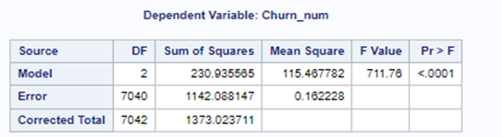
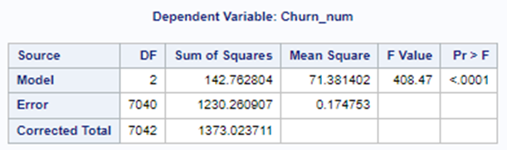
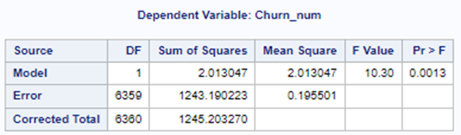
Hypotheses testing (Figures)
Type of Contract vs. Churn
Internet Service vs. Churn
High F-value = High variability
P-value (<.0001) < 0.05 = True relationship
High F-value = High variability
P-value (<.0001) < 0.05 = True relationship
# of lines vs. Churn
Low F-value = Low variability
P-value (.0013) < 0.05 = True relationship
Notes:
This slide display the three ANOVA tables generated in SAS Studio for each of the research questions.
The relationship between the means of type of contract and customer churn showed high variability in a relationship that is not due to random chance since the p-value was less than the specified significance level of 0.05.
Similarly, the relationship between the means of type of internet service and customer churn showed high variability in a relationship that is not due to random chance since the p-value was less than the specified significance level of 0.05.
Unlike the other two variables, the relationship between the means of number of lines and customer churn showed low variability in a relationship that is still nonetheless, not due to random chance since the p-value was less than the specified significance level of 0.05.

Slide 13
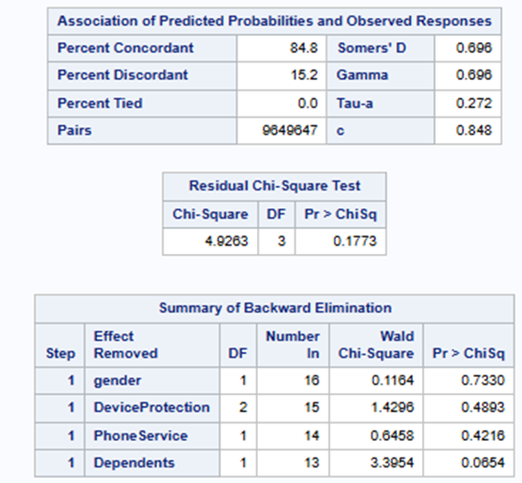
Logistic Regression Model Results
Fast backward selection.
Correct predictions 84.8% of the time.
Incorrect predictions 15.2% of the time.
P-value indicates good fit for the data after variable removal.
Variables “Gender”, “DeviceProtection”, “PhoneService”, and “Dependents” can be removed.
Notes:
This slide covers the summary of the results of the main deliverable of this project, a logistic regression model that uses customer churn as the target variable.
A fast backward selection was used in this model in order to run a model that uses all of the specified variables and eliminates insignificant variables within the first iteration instead of removing a single variable during every step.
After running the model, the predicted probabilities table shows that the model produced correct predictions 84.8% of the time and incorrect predictions 15.2% of the time.
In the residual Chi-square test table, the p-value of .1773 is greater than the significance level of .05, this confirms the model fits the data well.
Lastly, the last table provides a summary of the variables that can be removed from the model because they don’t necessarily improve the predictive performance of the model.

Slide 14
Recommendations
Leverage predictive models to identify key variables with proven impact on customer churn.
Design more effective customer retention strategies and incentives tailored to customers at-risk of churn based on predictive modeling.
Remove variables that are not statistically significant from data collection jobs in further iterations of the model.
Include more demographic attributes.
Notes:
Companies in this industry should leverage predictive models to determine which customer attributes have an influence in customer churn.
Identifying statistically significant attributes with anticipation can help companies identify customers who are more likely to churn and design more effective customer retention strategies and incentives tailored to these specific customers.
For instance, based on the results, a company can offer discounts to customers with Fiber Optic internet service as these have shown to be more likely to churn. Another example could be to implement a cancellation fee to the month-to-month contract to keep those customers from churning even though that sounds like a more aggressive solution.
- In terms of data collection, variables that are not statistically significant or provide any improvements in predictive performance should be removed from the data collection jobs in future iterations.
Regarding the data collected, my research specifically showed that some of the variables are not relevant to build an effective model, such variables can be removed from data collection to save computational time and space.
On the other hand, to build a more robust model, other key attributes can be added to data collection to include more detailed information about customers, such as education level, income, economic class, geospatial data, age, marital status, number of previous providers, etc

Slide 15
Conclusion
Competition and technological innovation are key drivers of customer churn.
Rejecting the null hypothesis in all three instances indicates that customers’ historical demographic and account data can be used to predict the likelihood of churn.
Certain variables can help determine which customers are at risk of churn ahead of time.
A proactive approach is better than a reactive approach in mitigating customer churn.
Predictive models can help predict the likelihood of churn as well as key attributes.
Notes:
- Competition and technological innovation fuel the increase of customer churn in the telecommunications industry.
Using a proactive approach such as a logistic regression model can help companies in this industry generate more effective customer retention strategies targeted towards those customers with a higher likelihood of churn.
The results provide strong evidence that my model is significantly better at predicting customer churn with the variables I selected than a model with no predictors aside from suggesting the removal of four of the variables which show minimal contribution to the predictive capability of the model.

Slide 16
References
Adekunte, P. A., Sadiku, J. O., & Sadiku, M. N. O. (2024, November 20). Telecommunications industry: An overview. International Journal of Trend in Scientific Research and Development. https://www.ijtsrd.com/engineering/telecommunications/71624/telecommunications-industry- anoverview/matthew-n-o-sadiku
BlastChar. (2018, February 23). Telco customer churn. Kaggle. https://www.kaggle.com/datasets/blastchar/telco-customer-churn
Kumar, S. (n.d.). Perspectives from the Global Telecom Outlook 2023–2027. PwC. https://www.pwc.com/gx/en/industries/tmt/assets/pwc-gto-2023.pdf
Meena, M., & Geng, J. (2022, April 26). Dynamic Competition in Telecommunications: A systematic Literature Review. Sage Journals. https://journals.sagepub.com/doi/10.1177/21582440221094609
Rani, K. S., Thalisma, S., Prasanna, N. G. L., Vindhya, R., & Srilakshmi, P. (2021, September 8). Analysis of Customer Churn Prediction in Telecom Industry Using Logistic Regression. SSRN. https://papers.ssrn.com/sol3/papers.cfm?abstract_id=3902033
Reasons for customer churn in Telecoms [survey results]. TechSee. (2019). https://techsee.com/resources/reports/2019-telecom-churn-survey/
SAS ondemand for academics. SAS OnDemand for Academics. (n.d.). https://welcome.oda.sas.com/
Understanding the role of telecommunications in the modern world. Advancing Communication Technology for a Connected World. (2024, December 2). https://www.aal persona.org/understanding-the-role-of-telecommunications-in-the-modern-world/

